Slide 1
PARTIAL DIFFERENTIAL EQUATIONS
Finite Difference Method
Dr. Anirban Tarafdar
Amrita Vishwa Vidyapeetham, Faridabad

Slide 2
Numerical methods
Most PDEs cannot be solved analytically.
Variable separation works only for some
simple cases and in particular usually not
for inhomogenous and/or nonlinear PDEs.
Numerical methods require that the PDE
become discretized on a grid.
Finite difference methods are popular/
most commonly used in science. They replace differential equation by difference equations)
Engineers (and a growing number of
scientists too) often use Finite Elements.

Slide 3

Finite differences
Remember the definition of differential quotient:
How to compute differential quotient numerically?
Just apply the formular above for a finite h.
For simplicity we use an equidistant grid in
x=[0,h,2h,3h,......(n-1) h] and evaluate f(x)
on the corresponding grid points xi.
Grid resolution h must be sufficient high.
Depends strongly on function f(x)!

Slide 4
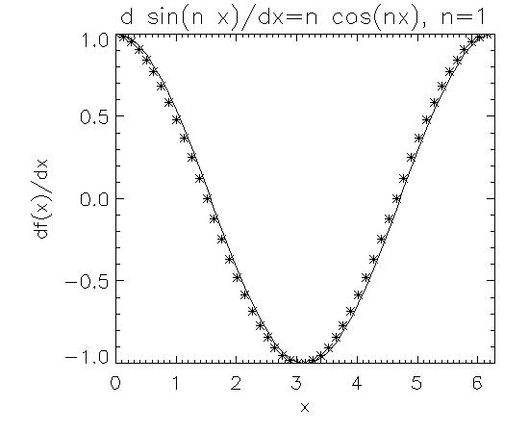
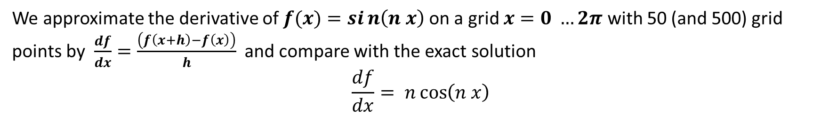
Accuracy of finite differences
We approximate the derivative of $f(x)=sin\left(n x\right)$on a grid $x=0 …2π$ with 50 (and 500) grid points by $\frac{df}{dx}=\frac{\left(f\left(x+h\right)−f\left(x\right)\right)}{h}$ and compare with the exact solution
$$\frac{df}{dx}= n\cos\left(n x\right)$$
Average error done by discretisation:
50 grid points: 0.040
500 grid points: 0.004

Slide 5
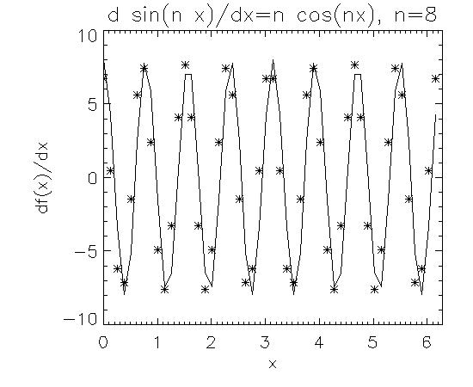
Accuracy of finite differences
We approximate the derivative of $f(x)=sin\left(n x\right)$on a grid $x=0 …2π$ with 50 (and 500) grid points by $\frac{df}{dx}=\frac{\left(f\left(x+h\right)−f\left(x\right)\right)}{h}$ and compare with the exact solution
$$\frac{df}{dx}= n\cos\left(n x\right)$$
Average error done by discretisation:
50 grid points: 2.49
500 grid points: 0.256

Slide 6

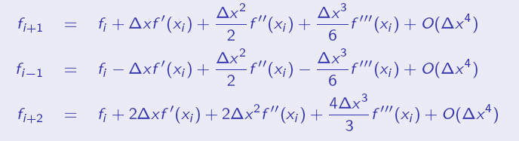
How to find higher order formulars?
For sufficient smooth functions we describe the function
f(x) locally by polynomial of nth order. To do so n+1
grid points are required. n defines the order of the scheme.
Make a Taylor expansion (Definition ):

Slide 7
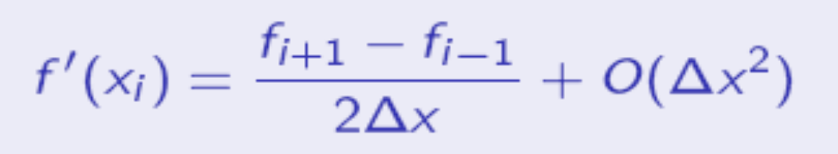

How to find higher order formulars?
And by linear combination we get the central difference:
At boundary points central differences might not be
possible (because the point i-1 does not exist at the
boundary i=0), but we can still find schemes of the
same order by one-sited (here right-sited) derivative:
Alternatives to one sited derivatives are periodic
boundary conditions or to introduce ghost-cells.

Slide 8
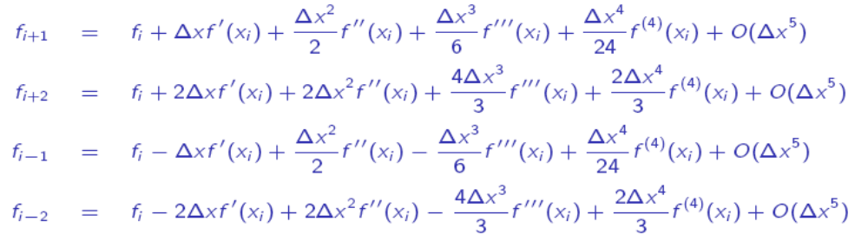

Higher order methods
By using more points (higher order polynomials) to approximate f(x) locally we can get higher orders, e.g. by an appropriate combination of
we get 4th order central differences:

Slide 9
Accuracy of finite differences
We approximate the derivative of f(x)=sin(n x) on
a grid x=0 ...2 Pi with 50 (and 500) grid points with
1th, 2th and 4th order schemes:
 | 1th order | 2th order | 4th order
n=1, 50 pixel | 0.04 | 0.0017 | 5.4 10⁻⁶
n=1, 500 pixel | 0.004 | 1.7 10⁻⁵ | 4.9 10⁻⁶
n=8, 50 pixel | 2.49 | 0.82 | 0.15
n=8, 500 pixel | 0.26 | 0.0086 | 4.5 10⁻⁵
n=20, 50 pixel | 13.5 | 9.9 | 8.1
n=20, 500 pix. | 1.60 | 0.13 | 0.0017

Slide 10
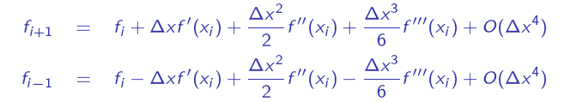
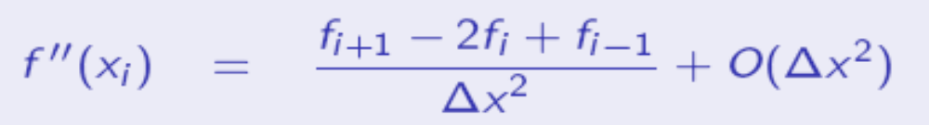
Higher derivatives
How to derive higher derivatives?
From the Taylor expansion
we derive by a linear combination:
Basic formular used to discretise
2.order Partial Differencial Equations

Slide 11
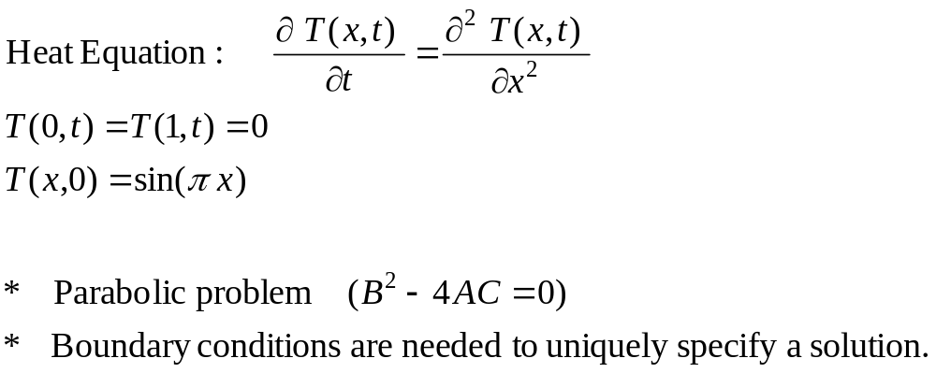
Parabolic Problems
ice
ice
x

Slide 12
Finite Difference Methods
Divide the interval x into sub-intervals, each of width h
Divide the interval t into sub-intervals, each of width k
A grid of points is used for
the finite difference solution
T_{i,j} represents T(x_{i}, t_{j})
Replace the derivates by
finite-difference formulas
t
x

Slide 13
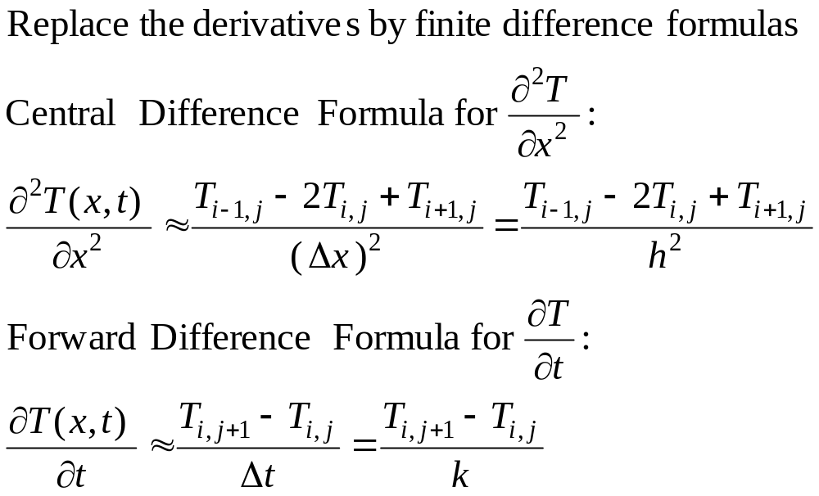
Finite Difference Methods

Slide 14
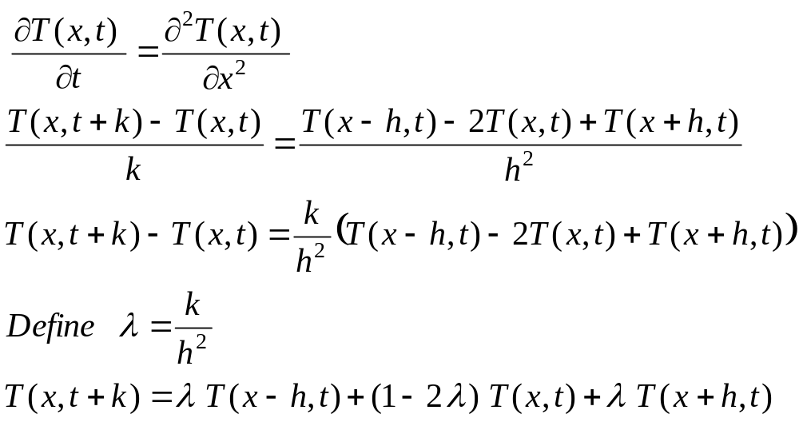
Explicit Method

Slide 15
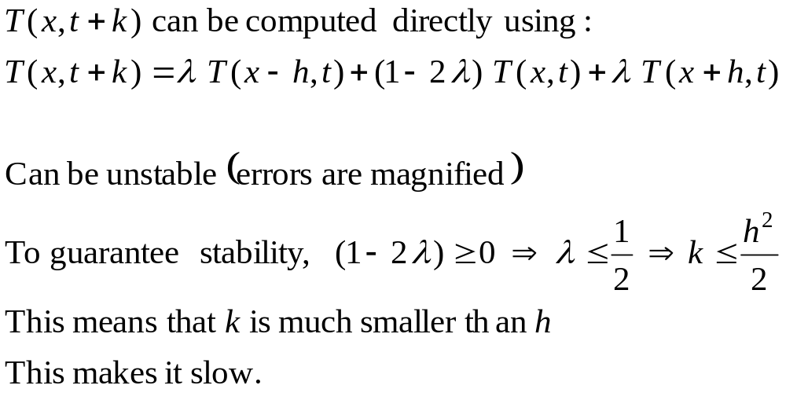
Convergence and Stability

Slide 16
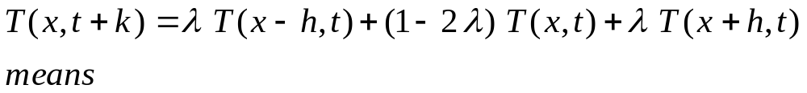
Explicit Method
How Do We Compute?
T(x,t+k)
T(x-h,t) T(x,t) T(x+h,t)

Slide 17
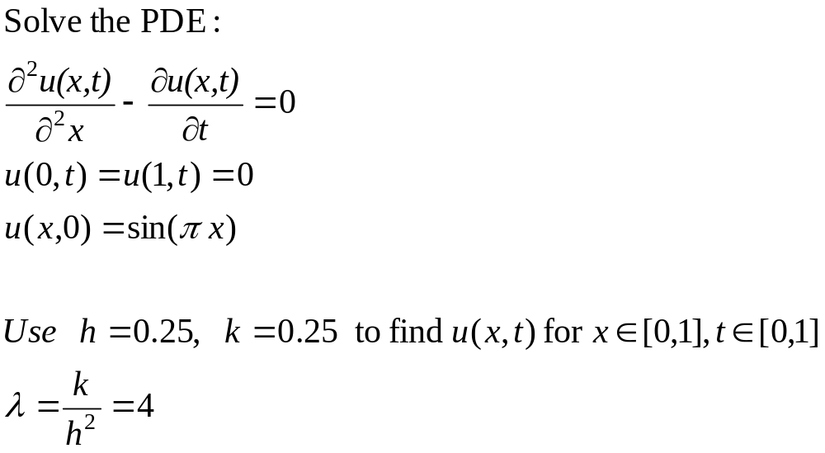
Example 1: Heat Equation
ice
ice
x

Slide 18
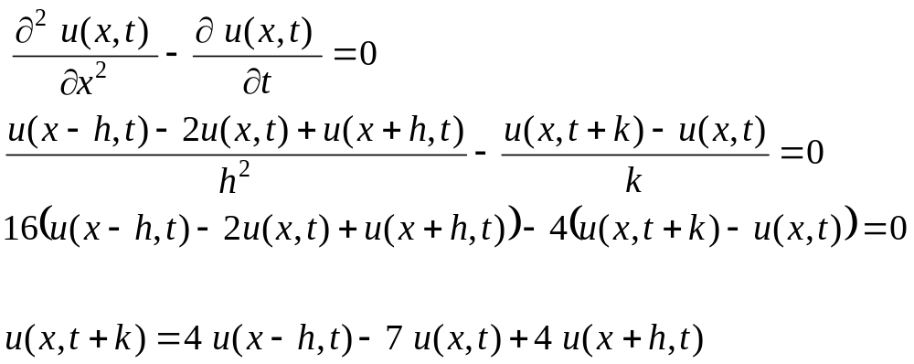
Example 1

Slide 19
Example 1
t=1.0
0
0
t=0.75
0
0
t=0.5
0
0
t=0.25
0
0
t=0
0
0
Sin(0.25π)
Sin(0. 5π)
Sin(0.75π)
x=0.0
x=0.25
x=0.5
x=0.75
x=1.0

Slide 20
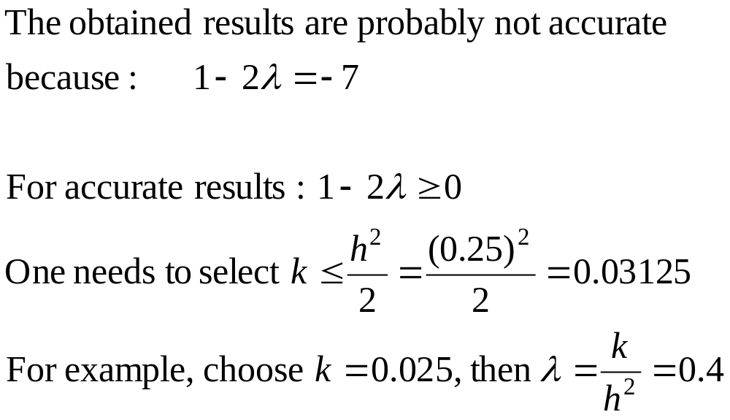
Remarks on Example 1

Slide 21
Example 1 – cont’d
t=0.10
0
0
t=0.075
0
0
t=0.05
0
0
t=0.025
0
0
t=0
0
0
Sin(0.25π)
Sin(0. 5π)
Sin(0.75π)
x=0.0
x=0.25
x=0.5
x=0.75
x=1.0

Slide 22
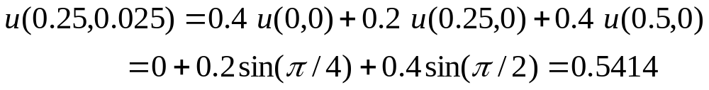
Example 1 – cont’d
t=0.10
0
0
t=0.075
0
0
t=0.05
0
0
t=0.025
0
0
t=0
0
0
Sin(0.25π)
Sin(0. 5π)
Sin(0.75π)
x=0.0
x=0.25
x=0.5
x=0.75
x=1.0

Slide 23
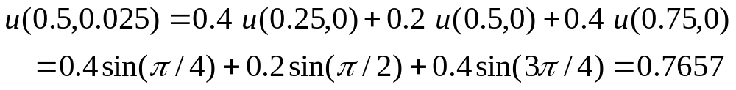
Example 1 – cont’d
t=0.10
0
0
t=0.075
0
0
t=0.05
0
0
t=0.025
0
0
t=0
0
0
Sin(0.25π)
Sin(0. 5π)
Sin(0.75π)
x=0.0
x=0.25
x=0.5
x=0.75
x=1.0

Slide 24
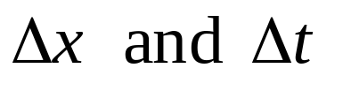
Convergence and Stability of the Solution
Convergence
The solutions converge means that the solution obtained using the finite difference method approaches the true solution as the steps approach zero.
Stability:
An algorithm is stable if the errors at each stage of the computation are not magnified as the computation progresses.

